Slide 1
Intro to Disabling ASLR

Slide 2
ASLR
Program
System
Exploit
Protection
Lower-byte of the DLL-Characteristic field of PE header

Slide 3
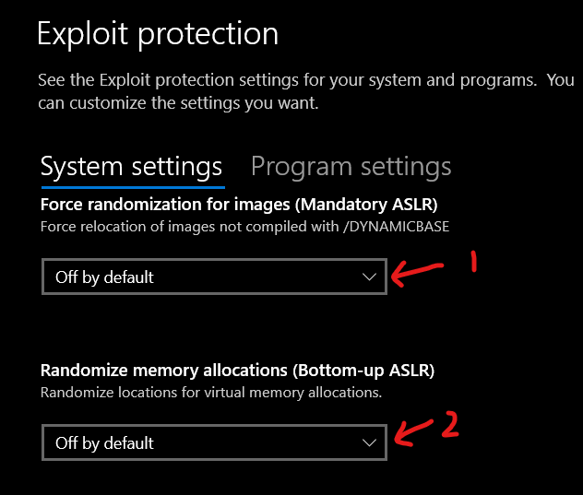

Slide 4
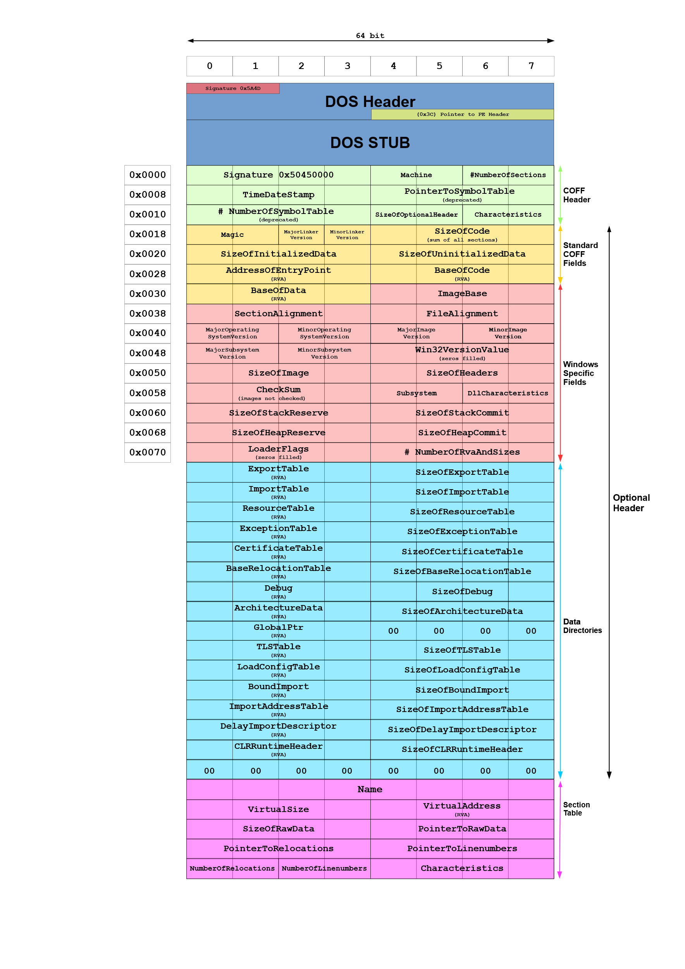
DLLCharacteristics

Slide 5
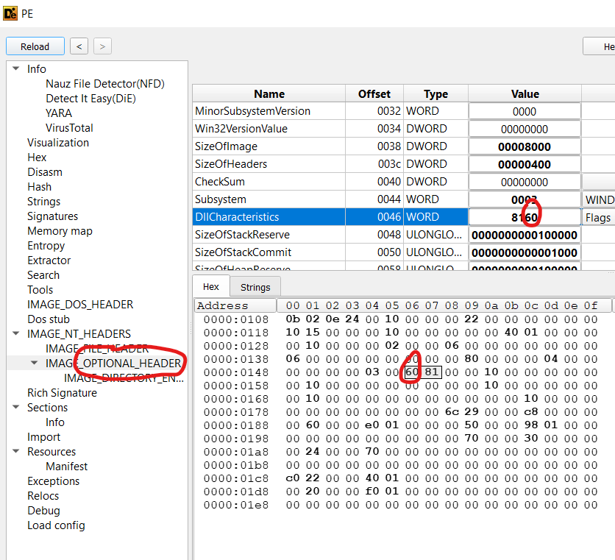
0x40 to 0x7F means it is
ASLR enabled
To disable ASLR, minus
0x40 from this value

